Slide 1
Machine Learning
Chapter 06
Bayesian Learning

Slide 2
INTRODUCTION
Bayesian learning algorithms calculate explicit probabilities for hypotheses
in this chapter we analyze FIND-S algorithms to determine conditions under which they output the most probable hypothesis given the training data.

Slide 3
Features of Bayesian learning methods include
Each observed training example can incrementally decrease or increase the estimated probability that a hypothesis is correct.
This provides a more flexible approach to learning than algorithms that completely eliminate a hypothesis if it is found to be inconsistent with any single example.
Prior knowledge can be combined with observed data to determine the final probability of a hypothesis.
Bayesian methods can accommodate hypotheses that make probabilistic predictions (e.g., hypotheses such as "this pneumonia patient has a 93% chance of complete recovery").

Slide 4
BAYES THEOREM
Bayes theorem provides a way to calculate the probability of a hypothesis based on its prior probability, the probabilities of observing various data given the hypothesis, and the observed data itself.
To define Bayes theorem
P(h) to denote the initial probability that hypothesis h holds, before we have observed the training data.
P(h) is often called the prior probability of h and may reflect any background knowledge we have about the chance that h is a correct hypothesis.
If we have no such prior knowledge, then we might simply assign the same prior probability to each candidate hypothesis.

Slide 5
Similarly, P(D) to denote the prior probability that training data D will be observed (i.e., the probability of D given no knowledge about which hypothesis holds).
P(D/h) to denote the probability of observing data D given some world in which hypothesis h holds.
The probability P(h/D) that h holds given the observed training data D.
P(h/D) is called the posterior probability of h, because it reflects our confidence that h holds after we have seen the training data D.

Slide 6
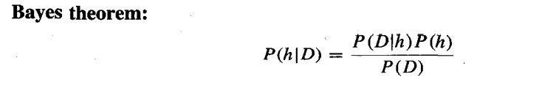
The posterior probability P(h/D) reflects the influence of the training data D, in contrast to the prior probability P(h) , which is independent of D.
Bayes theorem provides a way to calculate the posterior probability P(h/D), from the prior probability P(h), together with P(D) and P(D/h).

Slide 7
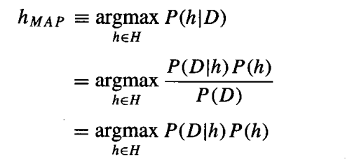
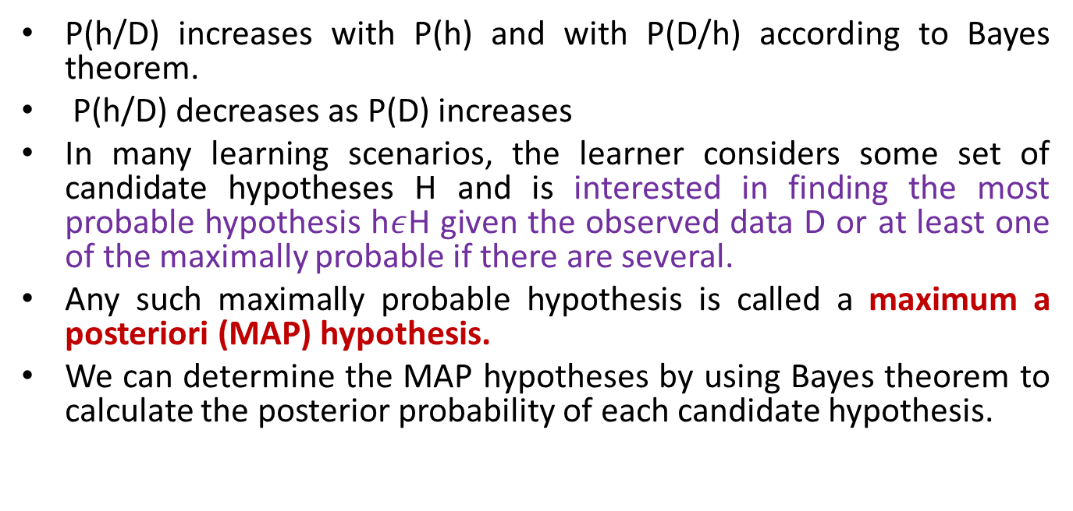
P(h/D) increases with P(h) and with P(D/h) according to Bayes theorem.
P(h/D) decreases as P(D) increases
In many learning scenarios, the learner considers some set of candidate hypotheses H and is interested in finding the most probable hypothesis h$ε$H given the observed data D or at least one of the maximally probable if there are several.
Any such maximally probable hypothesis is called a maximum a posteriori (MAP) hypothesis.
We can determine the MAP hypotheses by using Bayes theorem to calculate the posterior probability of each candidate hypothesis.
------6.2

Slide 8

we dropped the term P(D) because it is a constant
In some cases, we will assume that every hypothesis in H is equally probable a priori (P(hi) = P(hj) for all hi and hj in H).
In this case we can further simplify Equation 6.2 and consider only the term P(D/h) to find the most probable hypothesis.
P(D/h) is often called the likelihood of the data D given h, and any hypothesis that maximizes P(D/h) is called a maximum likelihood (ML) hypothesis,

Slide 9
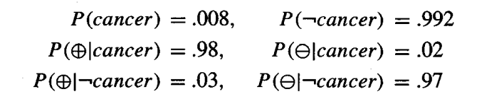
An Example
To illustrate Bayes rule, consider a medical diagnosis problem in which there are two alternative hypotheses:
(1) that the patient has a particular form of cancer. and
(2) that the patient does not.
The available data is from a laboratory test with two possible outcomes: + (positive) and - (negative).
We have prior knowledge that over the entire population of people only .008 have this disease. Furthermore, the lab test is only an imperfect indicator of the disease.
The test returns a correct positive result in only 98% of the cases in which the disease is actually present and a correct negative result in only 97% of the cases in which the disease is not present. In other cases, the test returns the opposite result.
The above situation can be summarized by the following probabilities:

Slide 10
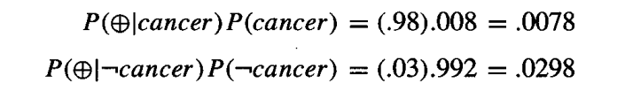
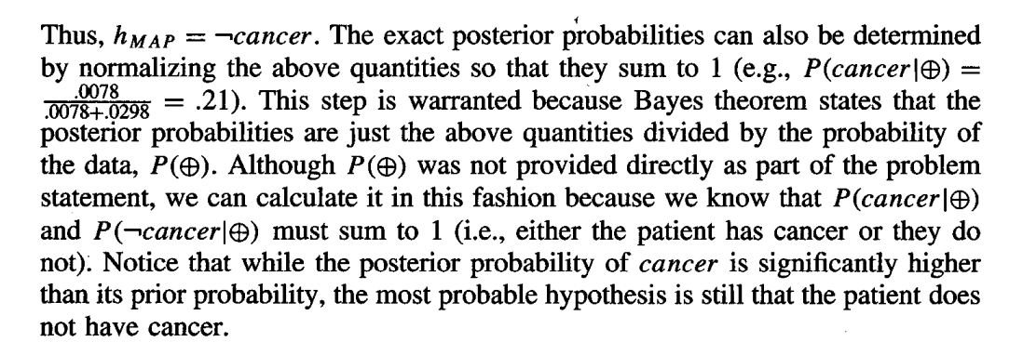
Suppose we now observe a new patient for whom the lab test returns a positive result. Should we diagnose the patient as having cancer or not? The maximum a posteriori hypothesis can be found using Equation 6.2

Slide 11
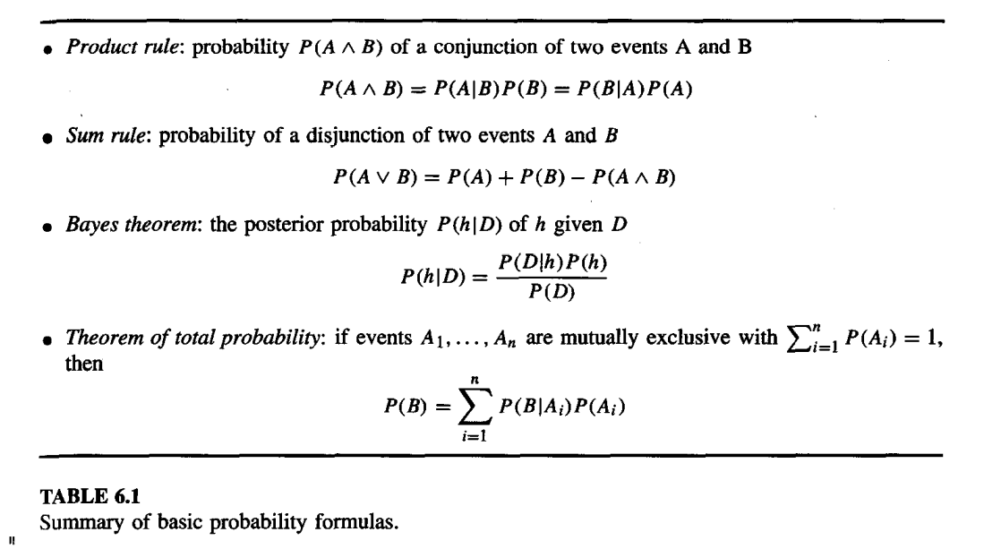
BAYES THEOREM AND CONCEPT LEARNING
Bayes theorem calculates the posterior probability of each hypothesis given the training data. It calculates the probability for each possible hypothesis, then outputs the most probable.

Slide 12
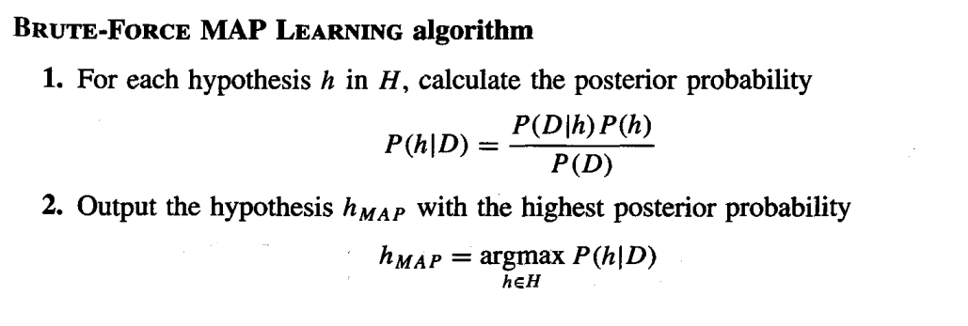
Brute-Force Bayes Concept Learning
Consider some finite hypothesis space H defined over the instance space X, in which the task is to learn some target concept c : X -> {0,1}.
Assume that the learner is given some sequence of training examples ((x1, d1) . . . (xm, dm)) where xi is some instance from X and where di is the target value of xi ( di = c(xi)).
We can design a concept learning algorithm to output the maximum a posteriori hypothesis, based on Bayes theorem, as follows:

Slide 13
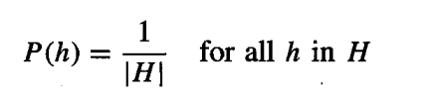
This algorithm applies Bayes theorem to each hypothesis in H to calculate P(h/D)
For the BRUTE-FORCE MAP LEARNING algorithm we must specify what values are to be used for P(h) and for P(D/h)
let us choose P(h) and P(D/h) to be consistent with the following assumptions:
1. The training data D is noise free (i.e., di = c(xi)).
2. The target concept c is contained in the hypothesis space H
3. We have no priori reason to believe that any hypothesis is more probable than any other.
Given no prior knowledge that one hypothesis is more likely than another, assign same prior probability to every hypothesis h in H. These prior probabilities sum to 1.

Slide 14
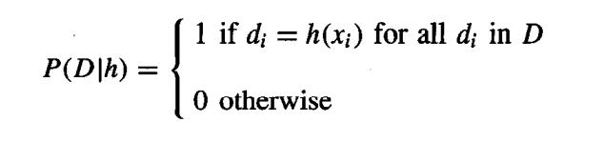
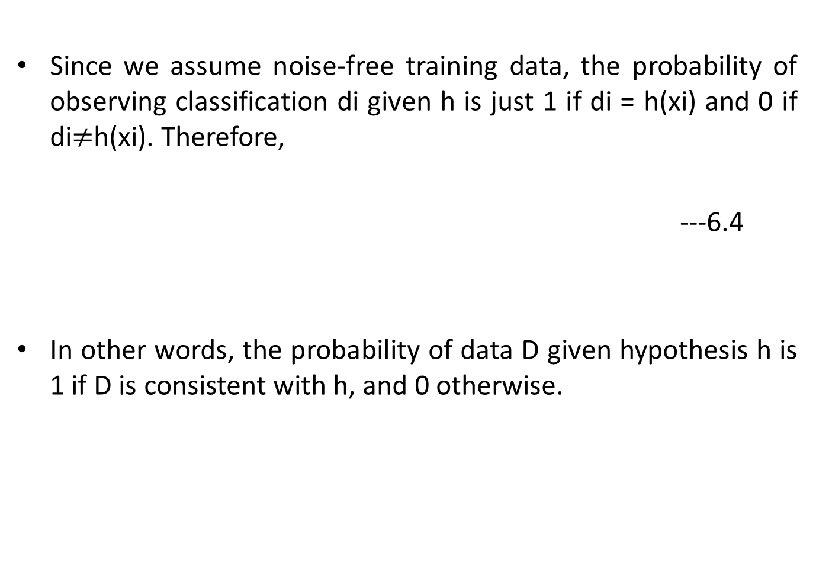
Since we assume noise-free training data, the probability of observing classification di given h is just 1 if di = h(xi) and 0 if di$≠$h(xi). Therefore,
---6.4
In other words, the probability of data D given hypothesis h is 1 if D is consistent with h, and 0 otherwise.

Slide 15
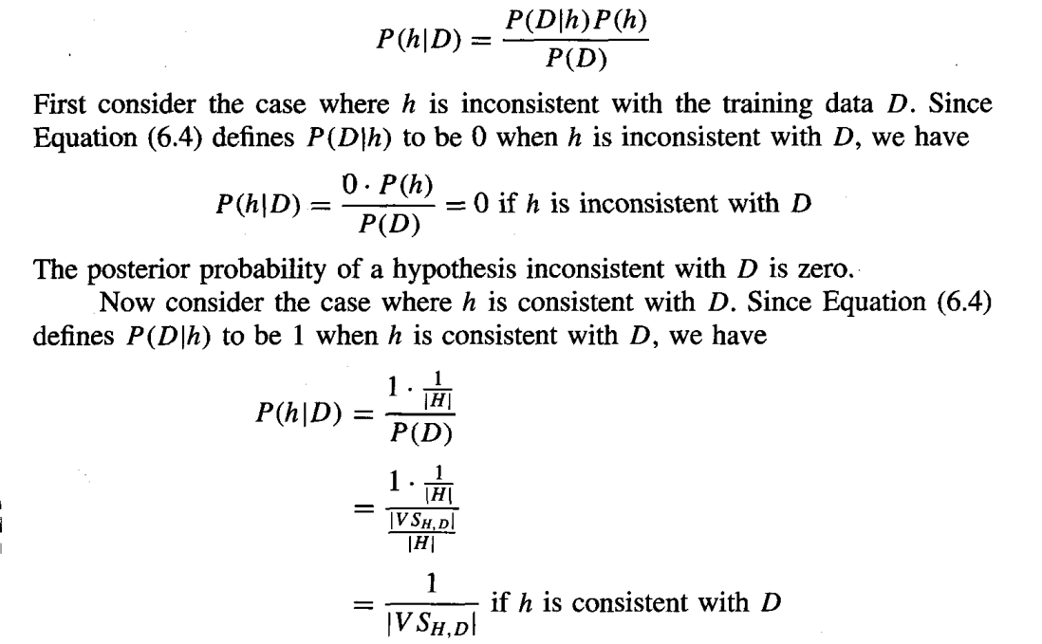

Slide 16
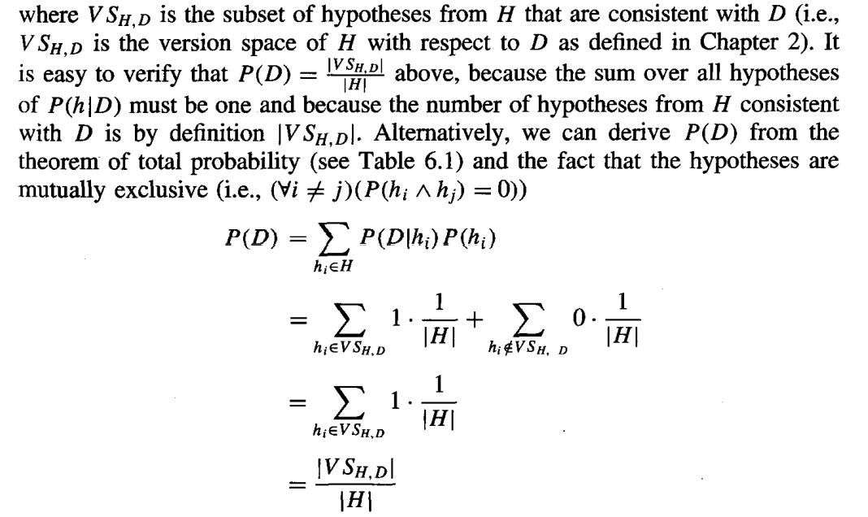

Slide 17
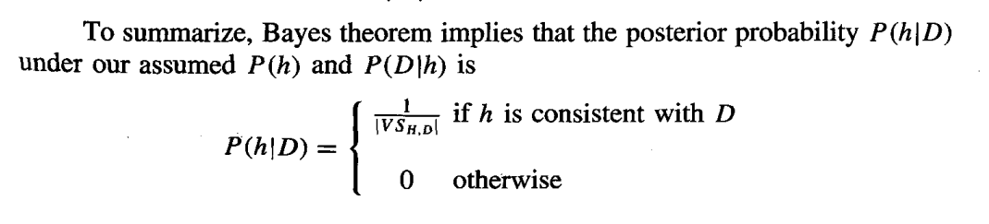
where |V_{SH,D}| is the number of hypotheses from H consistent with D.
Every consistent hypothesis has posterior probability (1/VS_{HD}), and every inconsistent hypothesis has posterior probability 0.
Every consistent hypothesis is, therefore, a MAP hypothesis.

Slide 18
The evolution of probabilities associated with hypotheses is depicted schematically in Figure 6.1.
Initially (Figure 6.1a) all hypotheses have the same probability.
As training data accumulates (Figures 6.1 b and 6. 1c), the posterior probability for inconsistent hypotheses becomes zero
while the total probability summing to one is shared equally among the remaining consistent hypotheses.

Slide 19
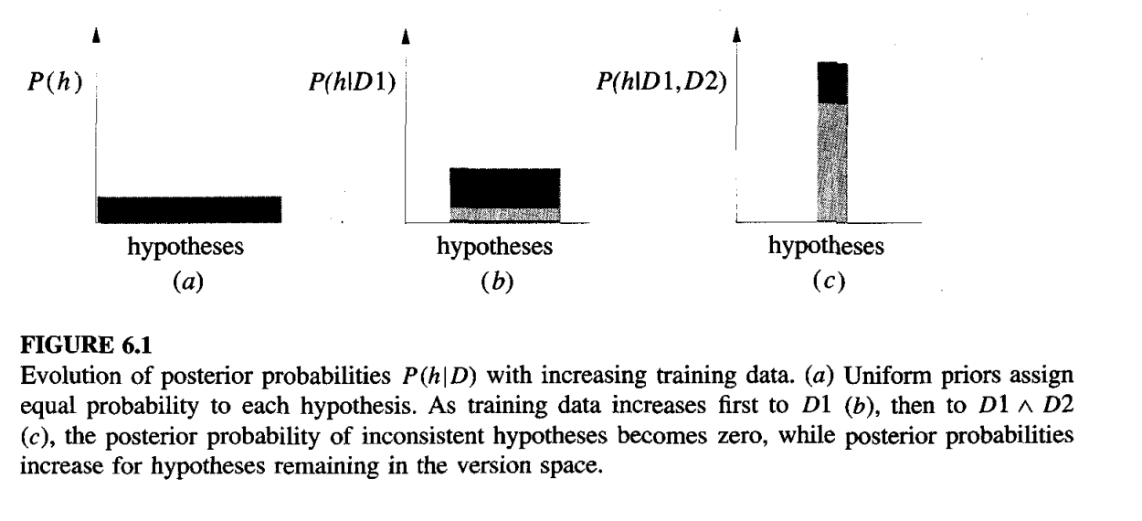

Slide 20
MAP Hypotheses and Consistent Learners
The above analysis shows that in the given setting, every hypothesis consistent with D is a MAP hypothesis.
We will say that a learning algorithm is a consistent learner provided it outputs a hypothesis that commits zero errors over the training examples.
we can conclude that every consistent learner outputs a MAP hypothesis, if we assume a uniform prior probability distribution over H (P(hi) = P(hj) for all i, j), and if we assume, noise free training data ( P(D/h) = 1 if D and h are consistent, and 0 otherwise).

Slide 21
Consider, the concept learning algorithm FIND-S searches the hypothesis space H from specific to general hypotheses, outputting a maximally specific consistent hypothesis (maximally specific member of the version space).
Because FIND-S outputs a consistent hypothesis, we know that it will output a MAP hypothesis under the probability distributions P(h) and P(D/h) defined above.
FIND-S does not explicitly manipulate probabilities at all -it simply outputs a maximally specific member of the version space.
However, by identifying distributions for P(h) and P(D/h) under which its output hypotheses will be MAP hypotheses, we have a useful way of characterizing the behavior of FIND-S.

Slide 22
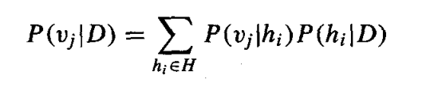
BAYES OPTIMAL CLASSIFIER
consider a hypothesis space containing three hypotheses, h1, h2, and h3.
Suppose that the posterior probabilities of these hypotheses given the training data are .4, .3, and .3 respectively.
Thus, h1 is the MAP hypothesis. Suppose a new instance x is encountered, which is classified positive by h1, but negative by h2 and h3.
Taking all hypotheses into account, the probability that x is positive is .4 and the probability that it is negative is therefore .6.
The most probable classification (negative) in this case is different from the classification generated by the MAP hypothesis.
the most probable classification of the new instance is obtained by combining the predictions of all hypotheses, weighted by their posterior probabilities.
If the possible classification of the new example can take on any value vj from some set V, then the probability P(vj/D) that the correct classification for the new instance is vj, is just

Slide 23
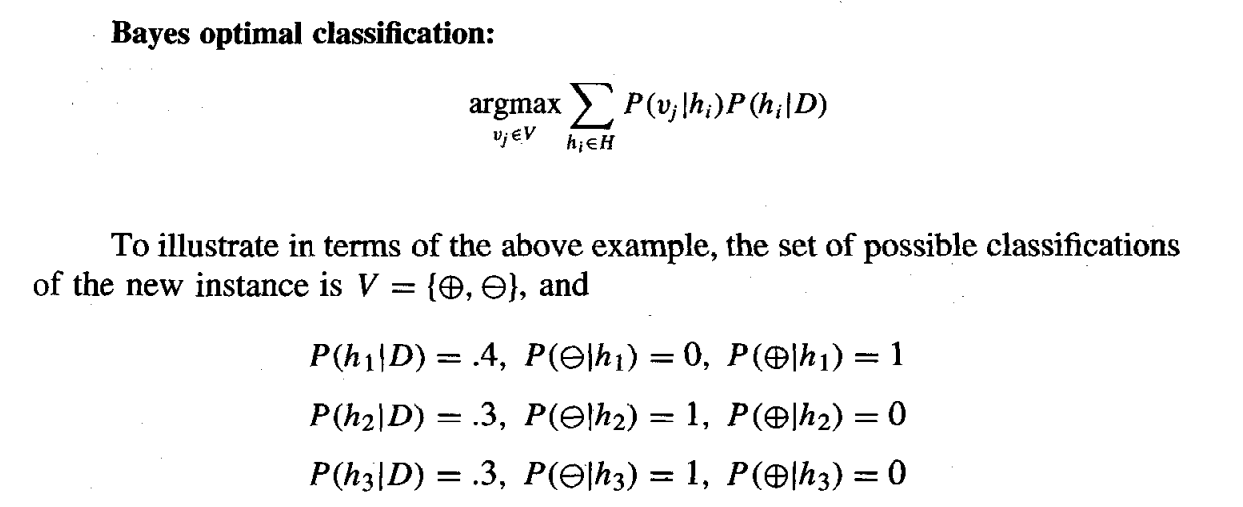
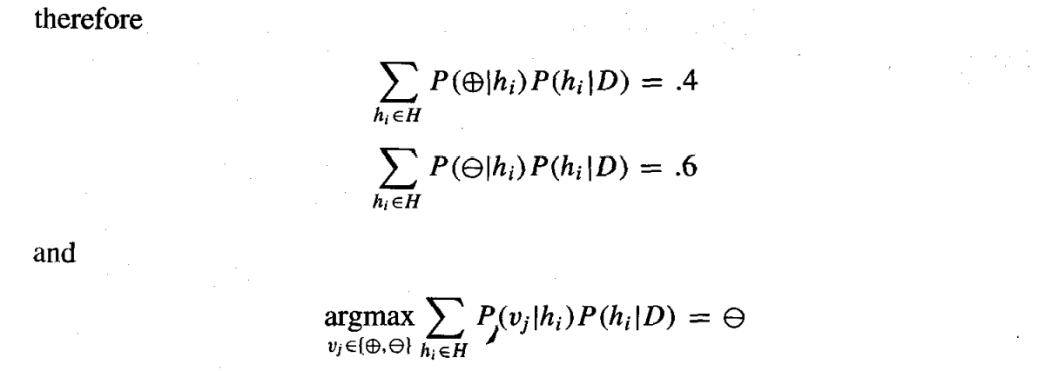
The optimal classification of the new instance is the value vj, for which P (vj/D) is maximum.

Slide 24
Any system that classifies new instances according to Equation is called a Bayes optimal classifier
This method maximizes the probability that the new instance is classified correctly

Slide 25
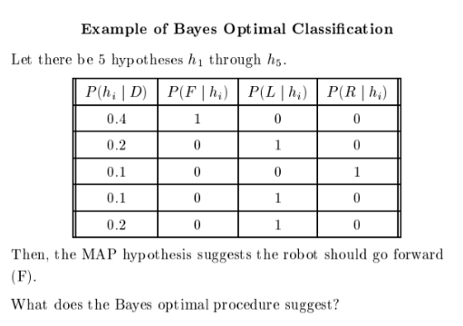

Slide 26
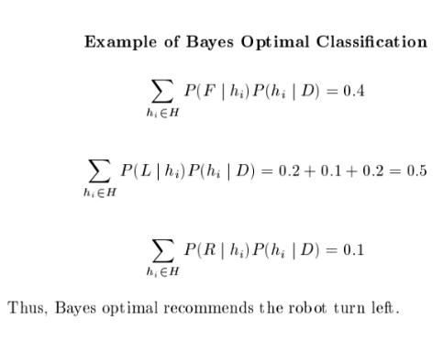

Slide 27
NAIVE BAYES CLASSIFIER
The naive Bayes classifier applies to learning tasks where each instance x is described by a conjunction of attribute values and where the target function f (x) can take on any value from some finite set V.
A set of training examples of the target function is provided, and a new instance is presented, described by the tuple of attribute values (a1, a2.. .an).
The learner is asked to predict the target value
The Bayesian approach to classifying the new instance is to assign the most probable target value V_{MAP} .

Slide 28
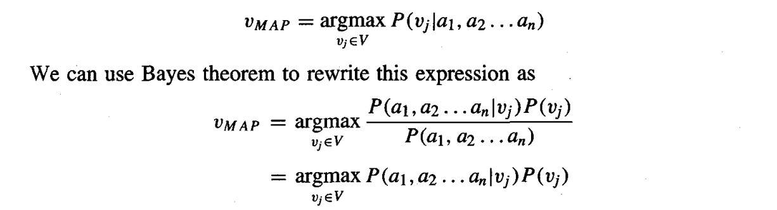
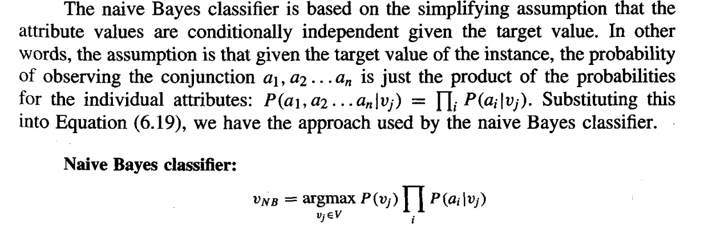
Estimate each of the P(vj) simply by counting the frequency with which each target value vj occurs in the training data.
-----6.19
-----6.20

Slide 29
Where V_{NB} denotes the target value output by the naive Bayes classifier.
the naive Bayes learning method involves a learning step in which the various P(vj) and P(ai/vj) terms are estimated, based on their frequencies over the training data.
The set of these estimates corresponds to the learned hypothesis.

Slide 30
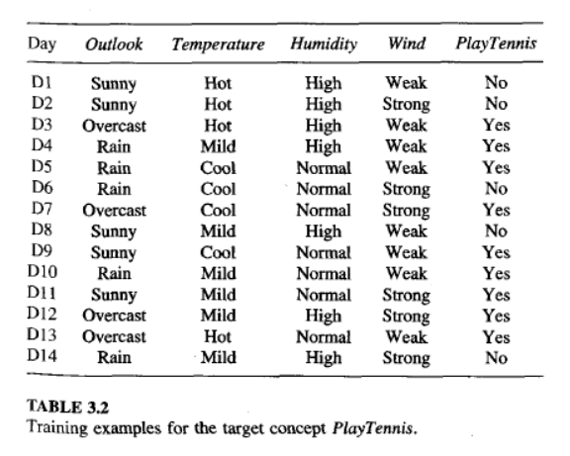

Slide 31
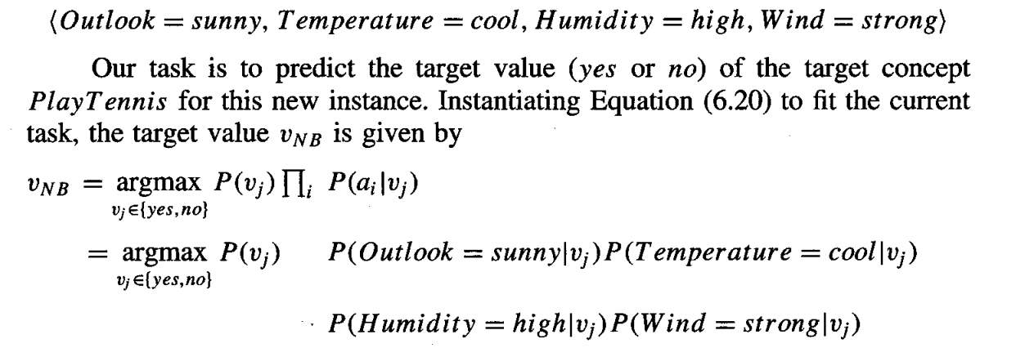
An Illustrative Example
Let us apply the naive Bayes classifier to a concept learning problem we considered during our discussion of decision tree learning: classifying days according to whether someone will play tennis. Table 3.2 from Chapter 3 provides a set of 14 training examples of the target concept PlayTennis, where each day is described by the attributes Outlook, Temperature, Humidity, and Wind. Here we use the naive Bayes classifier and the training data from this table to classify the following novel instance:
-----6.20
-----6.21

Slide 32
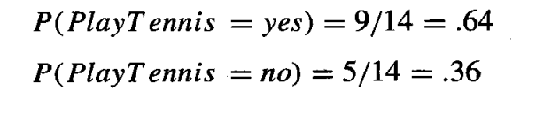
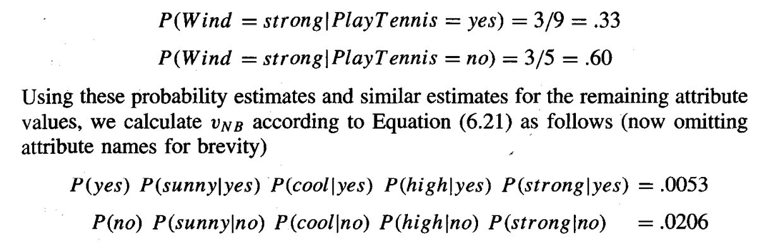
First, the probabilities of the different target values can easily be estimated based on their frequencies over the 14 training examples
Similarly, we can estimate the conditional probabilities.
for Wind = strong are

Slide 33
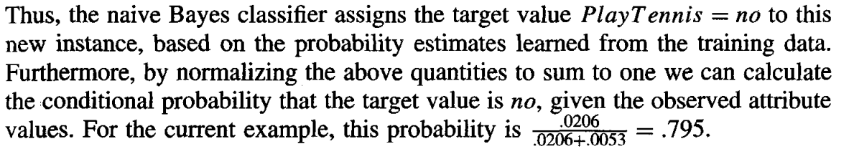

Slide 34
ESTIMATING PROBABILITIES
Up to this point we have estimated probabilities by the fraction of times the event is observed to occur over the total number of opportunities.
For example, in the above case we estimated P(Wind = strong|Play Tennis = no) by the fraction n_{c} /n where n = 5 is the total number of training examples for which PlayTennis = no, and n_{c} = 3 is the number of these for which Wind = strong.
While this observed fraction provides a good estimate of the probability in many cases, it provides poor estimates when n_{c} is very small.

Slide 35
To see the difficulty, imagine that the value of P(Wind = strong l PlayTennis = no) is .08 and that we have a sample containing only 5 examples for which PlayTennis = no.
Then the most probable value for n_{c} is 0. This raises two difficulties.
First, n_{c}/n produces a biased underestimate of the probability.
Second, when this probability estimate is zero, this probability term will dominate the Bayes classifier if the future query contains Wind = strong.
The reason is that the quantity calculated in Equation (6.20) requires multiplying all the other probability terms by this zero value.

Slide 36
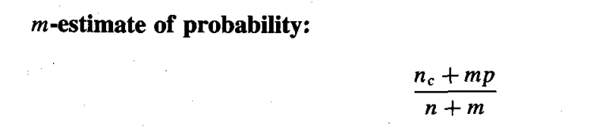
To avoid this difficulty we can adopt using the m-estimate defined as follows.
p is our prior estimate of the probability we wish to determine,
and m is a constant called the equivalent sample size
which determines how heavily to weight p relative to the observed data.
choosing p in the absence of other information is to assume uniform prior probability.
6.22

Slide 37
that is, if an attribute has k possible values we set p = 1/k.
For example, In estimating P(Wind =stronglPlayTennis = no) we note the attribute Wind has two possible values(strong and weak), so uniform priors would correspond to choosing p = .5.
if m is zero, the m-estimate is equivalent to the simple fraction n_{c}/n .
If both n and m are nonzero, then the observed fraction n_{c}/n and prior p will be combined according to the weight m.
m is called the equivalent sample in Equation (6.22) can be interpreted as augmenting the n actual observations by an additional m virtual samples distributed according to p.

Slide 38
BAYESIAN BELIEF NETWORKS
the naive Bayes classifier, assumes that all the variables are conditionally independent given the value of the target variable,
Bayesian belief networks allow conditional independence assumptions that apply to subsets of the variables.

Slide 39
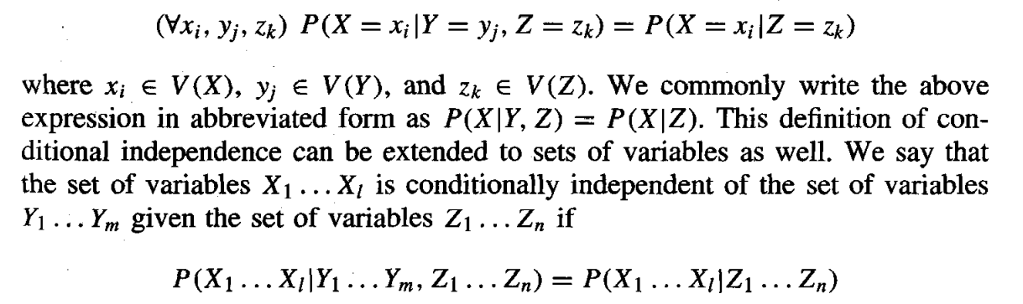
Conditional Independence
Let X, Y, and Z be three discrete-valued random variables. We say that X is conditionally independent of Y given Z if the probability distribution governing X is independent of the value of Y given a value for Z; that is, if

Slide 40
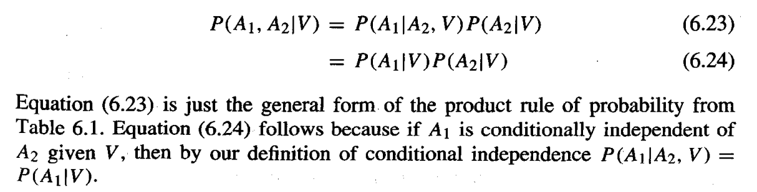
The naive Bayes classifier assumes that the instance attribute A1 is conditionally independent of instance attribute A2 given the target value V. This allows the naive Bayes classifier to calculate P(A1, A2/V)

Slide 41
Representation
A Bayesian belief network represents the joint probability distribution for a set of variables.
For example, the Bayesian network in Figure 6.3 represents the joint probability distribution over the boolean variables Storm, Lightning, Thunder, ForestFire, Campfire, and BusTourGroup.
Each variable in the joint space is represented by a node in the Bayesian network.
For each variable two types of information are specified.

Slide 42
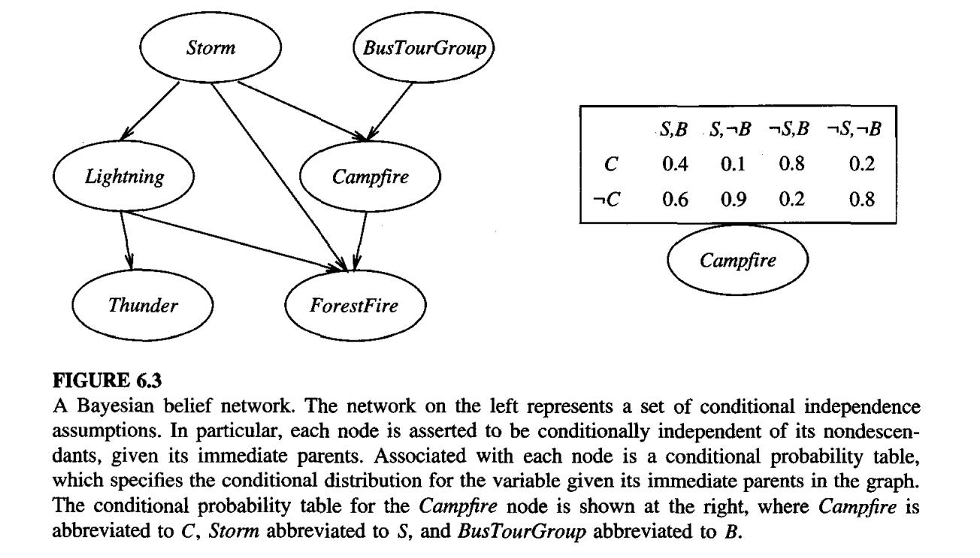

Slide 43
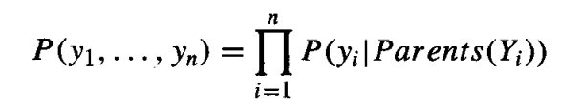
First, the network arcs represent the assertion that the variable is conditionally independent of its non descendants in the network given its immediate predecessors in the network.
We say X is a descendant of Y if there is a directed path from Y to X.
Second, a conditional probability table is given for each variable, describing the probability distribution for that variable given the values of its immediate predecessors.
The joint probability for any desired assignment of values (y1, . . . , yn) to the tuple of network variables (Y1 . . . Yn) can be computed by the formula

Slide 44
where Parents(Yi) denotes the set of immediate predecessors of Yi in the network. The values of P(yi/ Parents(Yi)) are precisely the values stored in the conditional probability table associated with node Yi.
To illustrate, the Bayesian network in Figure 6.3 represents the joint probability distribution over the boolean variables Storm, Lightning, Thunder, Forest, Fire, Campfire, and BusTourGroup.
Consider the node Campfire. The network nodes and arcs represent the assertion that Campfire is conditionally independent of its non descendants Lightning and Thunder, given its immediate parents Storm and BusTourGroup.

Slide 45
This means that once we know the value of the variables Storm and BusTourGroup, the variables Lightning and Thunder provide no additional information about Campfire.
The right side of the figure shows the conditional probability table associated with the variable Campfire. The top left entry in this table, for example, expresses the assertion that

Slide 46
Inference : We wish to use a Bayesian network to infer the value of some target variable (e.g., ForestFire) given the observed values of the other variables.
What we really wish to infer is the probability distribution for the target variable, which specifies the probability that it will take on each of its possible values given the observed values of the other variables.
This inference step can be straightforward if values for all of the other variables in the network are known exactly.
In the more general case we may wish to infer the probability distribution for some variable (e.g., ForestFire) given observed values for only a subset of the other variables (e.g., Thunder and BusTourGroup may be the only observed values available).
In general, a Bayesian network can be used to compute the probability distribution for any subset of network variables given the values or distributions for any subset of the remaining variables.

Slide 47
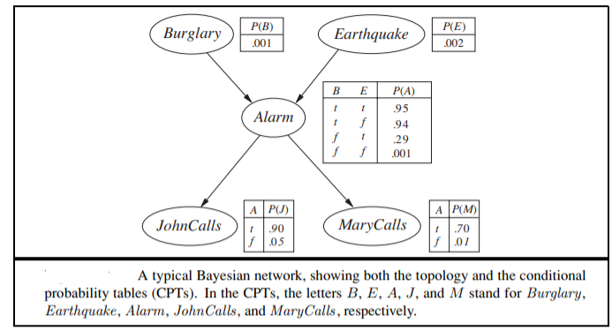

Slide 48

P(j,m, a,￢b,￢e)
= P(j | a)P(m| a)P(a | ￢b∧ ￢e)P(￢b)P(￢e)
= 0.90 × 0.70 × 0.001 × 0.999 × 0.998 = 0.000628 .

Slide 49
THE EM ALGORITHM
In many practical learning settings, only a subset of the relevant instance features might be observable.
For example, in training or using the Bayesian belief network of Figure 6.3, we might have data where only a subset of the network variables Storm, Lightning, Thunder, ForestFire, Campfire, and BusTourGroup have been observed
the EM algorithm a widely used approach to learning in the presence of unobserved variables.

Slide 50
Estimating Means of k Gaussians
Consider a problem in which the data D is a set of instances generated by a probability distribution that is a mixture of k distinct Normal distributions.
in Figure 6.4 for the case where k = 2 and where the instances are the points shown along the x axis. Each instance is generated using a two-step process.
First, one of the k Normal distributions is selected at random.
Second, a single random instance xi is generated according to this selected distribution.
This process is repeated to generate a set of data points as shown in the figure
selection of the single Normal distribution at each step is based on choosing each with uniform probability, where each of the k Normal distributions has the same variance σ ² , and where σ ² is known.
The learning task is to output a hypothesis h = (μ1, . . . μk) that describes the means of each of the k distributions.
We would like to find a maximum likelihood hypothesis for these means; that is, a hypothesis h that maximizes p(D/h).

Slide 51
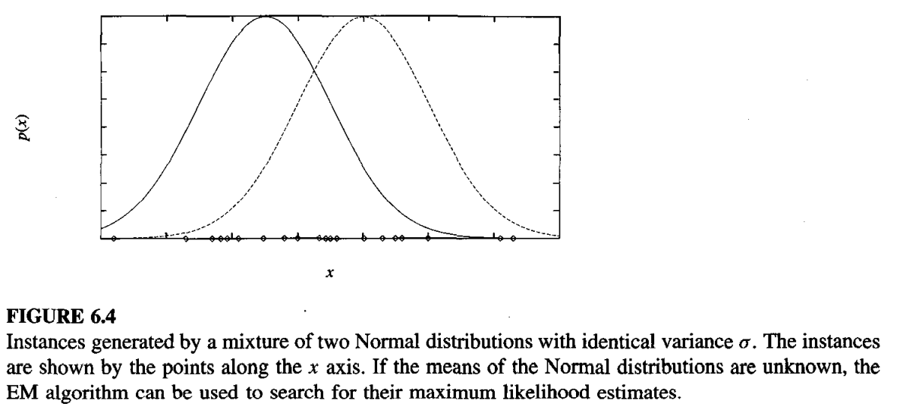

Slide 52
Our problem here, involves a mixture of k different Normal distributions, and we cannot observe which instances were generated by which distribution.
Thus, we have a example of a problem involving hidden variables. In the example of Figure 6.4,
we can think of the full description of each instance as the triple (xi, zi l, ziz), where xi is the observed value of the ith instance and where zil and zi2 indicate which of the two Normal distributions was used to generate the value xi.
In particular, zij has the value 1 if xi was created by the jth Normal distribution and 0 otherwise.
Here xi is the observed variable in the description of the instance, and zil and zi2 are hidden variables.

Slide 53
Applied to our k-means problem the EM algorithm searches for a maximum likelihood hypothesis by repeatedly re-estimating the expected values of the hidden variables zij given its current hypothesis (µI . . . µk),
then recalculating the maximum likelihood hypothesis using these expected values for the hidden variables.

Slide 54
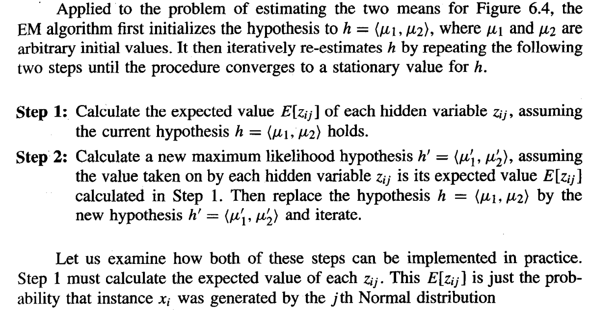

Slide 55
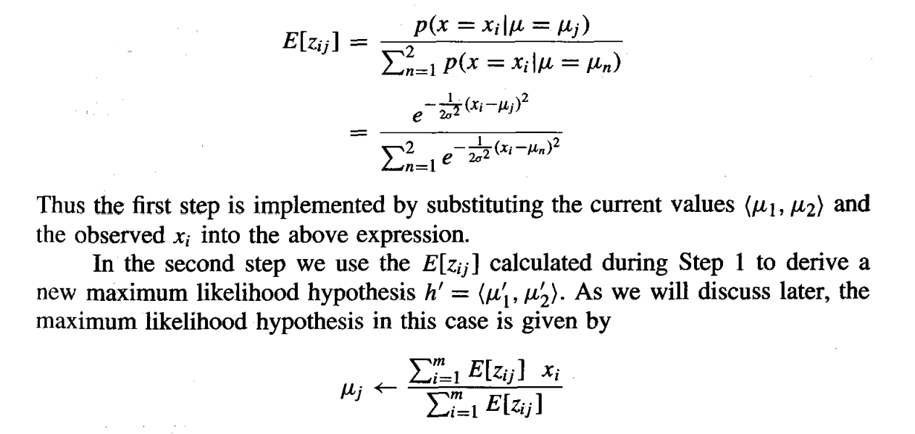

Slide 56
Air-Traffic Data Regarding the arrival of airplanes in the routes from any airport to New Delhi under certain conditions.
Days | Season | Fog | Rain | Class
Weekday | Spring | None | None | On Time
Weekday | Winter | None | Slight | On Time
Weekday | Winter | None | None | On Time
Holiday | Winter | High | Slight | Late
Saturday | Summer | Normal | None | On Time
Weekday | Autumn | Normal | None | Very Late
Holiday | Summer | High | Slight | On Time
Sunday | Summer | Normal | None | On Time
Weekday | Winter | High | Heavy | Very Late
Weekday | Summer | None | Slight | On Time
Cond. to next slide…

Slide 57
Air-Traffic Data
Days | Season | Fog | Rain | Class
Saturday | Spring | High | Heavy | Cancelled
Weekday | Summer | High | Slight | On Time
Weekday | Winter | Normal | None | Late
Weekday | Summer | High | None | On Time
Weekday | Winter | Normal | Heavy | Very Late
Saturday | Autumn | High | Slight | On Time
Weekday | Autumn | None | Heavy | On Time
Holiday | Spring | Normal | Slight | On Time
Weekday | Spring | Normal | None | On Time
Weekday | Spring | Normal | Heavy | On Time

Slide 58
Air-Traffic Data
In this database, there are four attributes
A = [ Day, Season, Fog, Rain]
with 20 tuples.
The categories of classes are:
C= [On Time, Late, Very Late, Cancelled]
Given this is the knowledge of data and classes, we are to find most likely classification for any other unseen instance, for example:
Classification technique eventually to map this tuple into an accurate class.
Week Day | Winter | High | None | ???

Slide 59
Naïve Bayesian Classifier
Example: With reference to the Air Traffic Dataset mentioned earlier, let us tabulate all the posterior and prior probabilities as shown below.
 |  | Class
Attribute |  | On Time | Late | Very Late | Cancelled
Day | Weekday | 9/14 = 0.64 | ½ = 0.5 | 3/3 = 1 | 0/1 = 0
 | Saturday | 2/14 = 0.14 | ½ = 0.5 | 0/3 = 0 | 1/1 = 1
 | Sunday | 1/14 = 0.07 | 0/2 = 0 | 0/3 = 0 | 0/1 = 0
 | Holiday | 2/14 = 0.14 | 0/2 = 0 | 0/3 = 0 | 0/1 = 0
Season | Spring | 4/14 = 0.29 | 0/2 = 0 | 0/3 = 0 | 0/1 = 0
 | Summer | 6/14 = 0.43 | 0/2 = 0 | 0/3 = 0 | 0/1 = 0
 | Autumn | 2/14 = 0.14 | 0/2 = 0 | 1/3= 0.33 | 0/1 = 0
 | Winter | 2/14 = 0.14 | 2/2 = 1 | 2/3 = 0.67 | 0/1 = 0

Slide 60
Naïve Bayesian Classifier
 |  | Class
Attribute |  | On Time | Late | Very Late | Cancelled
Fog | None | 5/14 = 0.36 | 0/2 = 0 | 0/3 = 0 | 0/1 = 0
 | High | 4/14 = 0.29 | 1/2 = 0.5 | 1/3 = 0.33 | 1/1 = 1
 | Normal | 5/14 = 0.36 | 1/2 = 0.5 | 2/3 = 0.67 | 0/1 = 0
Rain | None | 5/14 = 0.36 | 1/2 = 0.5 | 1/3 = 0.33 | 0/1 = 0
 | Slight | 8/14 = 0.57 | 0/2 = 0 | 0/3 = 0 | 0/1 = 0
 | Heavy | 1/14 = 0.07 | 1/2 = 0.5 | 2/3 = 0.67 | 1/1 = 1
Prior Probability |  | 14/20 = 0.70 | 2/20 = 0.10 | 3/20 = 0.15 | 1/20 = 0.05

Slide 61
Naïve Bayesian Classifier
Instance:
Case1: Class = On Time : 0.70 × 0.64 × 0.14 × 0.29 × 0.07 = 0.0013
Case2: Class = Late : 0.10 × 0.50 × 1.0 × 0.50 × 0.50 = 0.0125
Case3: Class = Very Late : 0.15 × 1.0 × 0.67 × 0.33 × 0.67 = 0.0222
Case4: Class = Cancelled : 0.05 × 0.0 × 0.0 × 1.0 × 1.0 = 0.0000
Case3 is the strongest; Hence correct classification is Very Late
Week Day | Winter | High | Heavy | ???

